Slide 1
7.6 Systems of Linear Inequalities
p. 156-158
Students will graph a system of linear inequlities.

Slide 2
Vocabulary p. 156
System of linear inequalities
Solution of a system of linear inequalities
2 or more linear inequalities in the same variables form a system of linear inequalities. Also called system of inequalities.
An ordered pair that is a solution of each inequality in the system.

Slide 3
Graphing a system of linear inequalities
p. 156
Step 1 the boundary lines of each inequality. Use a line if the inequality is < or > and a line if the inequality is < or >.
Step 2 the appropriate half-plane for each inequality.
Step 3 the solution of the system of inequalities as the intersection of the half-planes from Step 2.
Graph
dashed
solid
Shade
Identify

Slide 4
p. 157: Example 1 Graph a system of Two Linear Inequalities
Graph the system of linear inequalities.
y – x > -1 Inequality 1
x + 2y < 1 Inequality 2
Solution
Graph both inequalities in the same coordinate plane. The graph of the system is the overlap, or , of the two half-planes.
intersection

Slide 5
p. 157: Example 2 Graph a system of Three Linear Inequalities
Graph the system of linear inequalities.
y > -3 Inequality 1
x < 2 Inequality 2
y < x + 1 Inequality 3
Solution
The graph of y > -3 is the half-plane and the line .
The graph of x < 2 is the half plane to the of the line .
The graph of y < x + 1 is the half-plane the line .
Finally, the graph of the system is the , or , of the three half-planes.
on
above
solid
y = -3
left
dashed
y = 2
below
dashed
y = x + 1
overlap
intersection

Slide 6
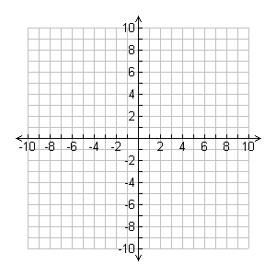
p. 157: Example 3 Write a System of Linear Inequalities
Write a system of inequalities that defines the shaded region at the right.
Solution
The graph of one inequality is the half-plane to the left of .
The graph of the other inequality is the half-plane to the right of .
The shaded region of the graph is the vertical band that lies the two vertical lines, and , but not the lines.
Answer The system of linear inequalities below defines the shaded region.
Inequality 1
Inequality 2
y = 2
y = -4
between
y = 2
y = -4
y < 2
y > -4

Slide 7
p. 158: Checkpoint
Complete the following Exercises
Graph the system of linear inequalities.
y < 2x + 2
y > -1/2x - 2

Slide 8
p. 158: Checkpoint
Complete the following Exercises
2. Write a system of linear inequalities that defines the shaded region.

