Slide 1
Propaganda Techniques
Emotional Button-pushing—appeals to emotional vulnerabilities!
Gets the audience to ignore the Real Issues!

Slide 2
Bandwagon
Bandwagon and "inevitable-victory" appeals attempt to persuade the target audience to join in and take the course of action that "everyone else is taking." → “Everyone else is doing it, and so should you!”
Inevitable victory: invites those not already on the bandwagon to join those already on the road to certain victory. Those already or at least partially on the bandwagon are reassured that staying aboard is their best course of action.
Join the crowd: This technique reinforces people's natural desire to be on the winning side. This technique is used to convince the audience that a program is an expression of an irresistible mass movement and that it is in their best interest to join.
an ad states that “Everyone is rushing down to their Ford dealer!”

Slide 3
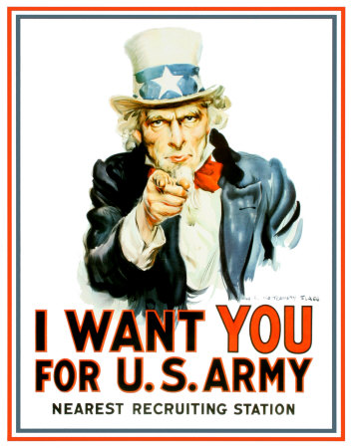
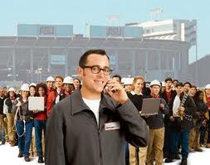
Bandwagon Illustrations

Slide 4
What Do You Think??

Slide 5
Card Stacking
deliberate action is taken to bias an argument, with opposing evidence being buried or discredited, whilst the case for one's own position is exaggerated at every opportunity. Thus the testimonial of supporters is used, but not that of opponents.
Coincidences and serendipity may be artificially created, making deliberate action seem like random occurrence. Things 'just seem to happen' while you are 'in town'.
A politician just happens to be in town when a new school is opening - so he just drops in, hi-jacking the press for his own means.
During election periods, political parties will often gag their loose cannons, who might open their mouths and say the wrong things.
A minister of a new church sect sets up in a poor area, feeds people who will listen, tells them of how the poor will be saved, and so on.

Slide 6
Card Stacking Illustration

Slide 7
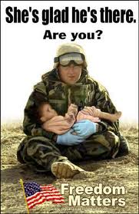
What Do You Think??
text

Slide 8
Circular Argument
An argument that commits the logical fallacy of assuming what it tries to prove
A formal logical fallacy in which the proposition to be proved is assumed implicitly or explicitly in one of the premises.
Such an argument is fallacious, because it relies upon its own proposition in order to support its central premise. Essentially, the argument assumes that its central point is already proven, and uses this in support of itself.
"Only an untrustworthy person would run for office. The fact that politicians are untrustworthy is proof of this.“
“You can’t give me a C. I’m an A student!”
“Richardson is the most successful mayor the town has ever had because he's the best mayor of our history.”
“Can a person quit smoking? Of course — as long as he has sufficient willpower and really wants to quit.” (ie. A person can quit because he can!)

Slide 9
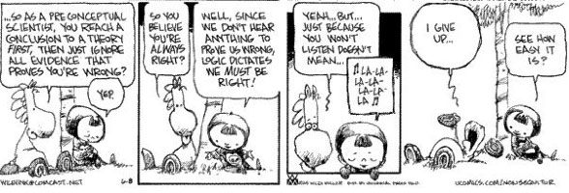
Circular Argument Illustration

Slide 10
Euphemisms
The substitution of an inoffensive term (such as "passed away") for one considered offensively explicit ("died"). Contrast with dysphemism.
Pre-owned for used or second-hand; enhanced interrogation for torture; industrial action for strike; misspoke for lie; tactical withdrawal for retreat; revenue augmentation for raising taxes; wind for belch or fart; convenience fee for surcharge; courtesy reminder for bill; unlawful combatant for prisoner of war
"Wardrobe malfunction" (Justin Timberlake's description of his tearing of Janet Jackson's costume during a half-time performance at Super Bowl XXXVIII)

Slide 11
Glittering Generalities/ Loaded Words
Emotionally appealing words applied to a product or idea, but which present no concrete argument or analysis. A famous example is the campaign slogan "Ford has a better idea!"
intangible nouns that embody ideals, such as dignity, freedom, fame, integrity, justice, love and respect.
"common good", "reform", "courage", "democracy", "freedom", "hope", "patriotism", "strength"
"He's a good American." "We're for family values."

Slide 12
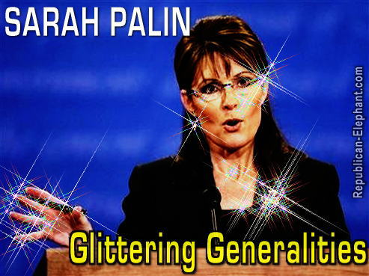
Glittering Generalities/ Loaded Words Illustrations

Slide 13
Hasty Generalization
A logical fallacy of faulty generalization by reaching an inductive generalization based on insufficient evidence. It commonly involves basing a broad conclusion upon the statistics of a survey of a small group that fails to sufficiently represent the whole population.
“9 out of 10 doctors recommend Bayer aspirin.” (1000 doctors were surveyed—did 991 recommend something else??)
Person A travels through Town X for the first time. He sees 10 people, all of them children. Person A returns to his town and reports that there are no adult residents in Town X.

Slide 14
Hasty Generalization Illustration
Therefore, US Healthcare is much worse than Canadian Healthcare.
.

Slide 15
Name Calling/ Stereotyping
Used to incite fears and arouse prejudices in an audience with the intent that the bad names will cause hearers to construct a negative opinion about a group or set of beliefs or ideas that the propagandist would wish hearers to denounce. The method is intended to provoke conclusions about a matter apart from impartial examinations of facts. Name-calling is thus a substitute for rational, fact-based arguments against the an idea or belief on its own merits.
The predecessor to Ad Hominem
"'The president sends out his attack dog often,' said [Senator Henry] Reid. 'That’s also known as Dick Cheney.‘”
My opponent is a flip-flop man who cannot make up his mind. He changes mind with the breeze! How could anyone follow such a weak-willed flip-flopper?
Especially in wartime, the other side gets given a whole slew of derogatory names. In the second world war, the Germans were called Huns, Krauts, the Boche, etc. The Japanese were called Nips, Japs, Slant-eyes, and so on.

Slide 16
Name Calling/ Stereotyping Illustration

Slide 17
Plain Folks
Attempts to convince the audience that the propagandist's positions reflect the common sense of the people. It is designed to win the confidence of the audience by communicating in the common manner and style of the target audience. Propagandists use ordinary language and mannerisms (and clothe their message in face-to-face and audiovisual communications) in attempting to identify their point of view with that of the average person.
a prominent politician eats at McDonald’s;
an actor or actress is photographed shopping for groceries

Slide 18
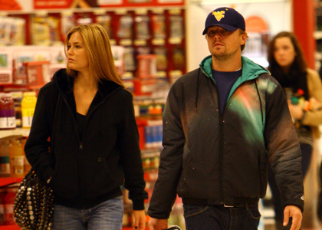
Plain Folks Illustrations

Slide 19
Red Herring
Presenting data or issues that, while compelling, are irrelevant to the argument at hand, and then claiming that it validates the argument.
: "ESASD should pave the lot behind the athletic fields. Besides, I can never find a parking space on campus anyway." The writer has changed the focus of the argument from paving to the scarcity of parking spaces, two ideas that may be related, but are not the same argument.

Slide 20
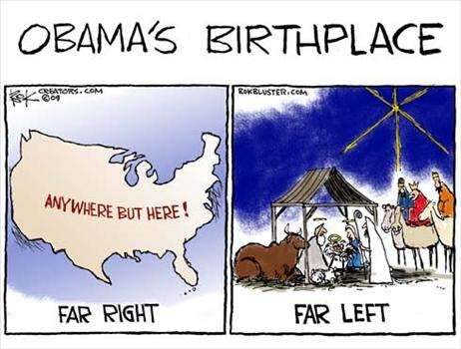
Red Herring Illustrations

Slide 21
Stereotyping
See Name-Calling
Cast those who you want to denigrate into an unpopular stereotype. Talk about the stereotypes as 'them', downplaying their rights as humans. Describe them as threatening, unworthy, disgusting and other negative frames.
Put emphasis on the stereotype words and the associations you want link to the stereotypes.
Name their leaders. Give exaggerated and distorted examples that 'prove' the stereotype and so condemn all who follow them.
Stereotyping can also be used to cast a group of people as good, perfect and otherwise wonderful and desirable.
These foreigners who come here and take all our jobs and suck dry all the social benefits of our democratic system. These are the parasites we must purge!
See Name-Calling for the Illustration

Slide 22
Testimonial
Testimonials are quotations, in or out of context, especially cited to support or reject a given policy, action, program, or personality. The reputation or the role (expert, respected public figure, etc.) of the individual giving the statement is exploited. The testimonial places the official sanction of a respected person or authority on a propaganda message. This is done in an effort to cause the target audience to identify itself with the authority or to accept the authority's opinions and beliefs as its own.
an athlete appears on the Wheaties box
an actor speaks at a political rally

Slide 23
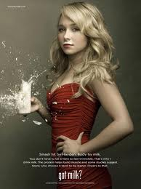
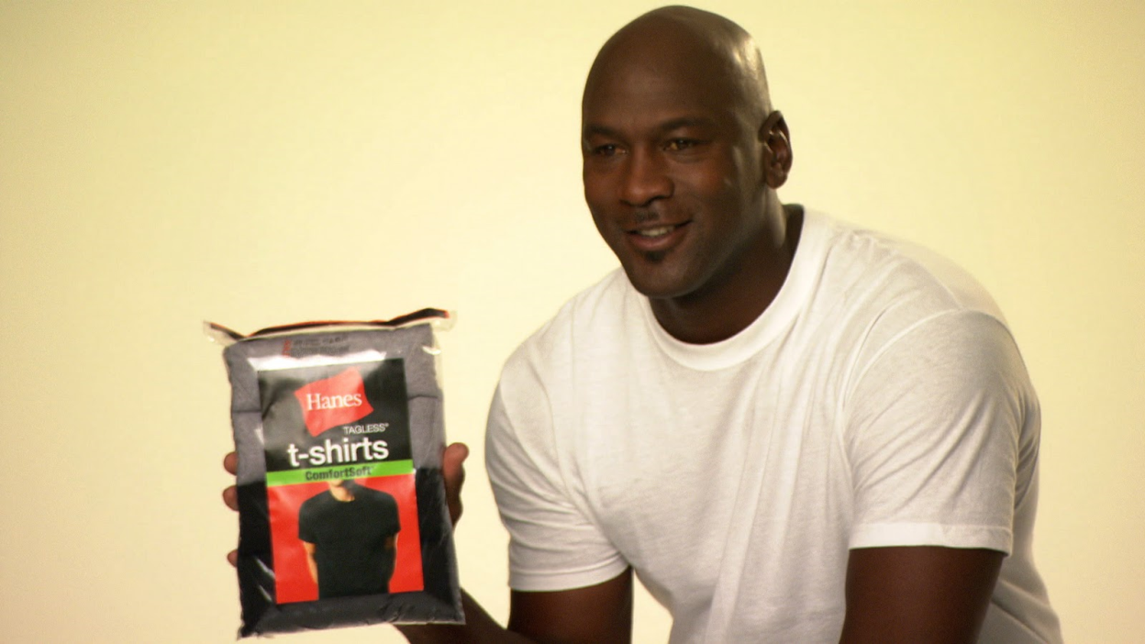
Testimonial Illustrations

Slide 24
Transfer
Also known as Association, this is a technique of projecting positive or negative qualities (praise or blame) of a person, entity, object, or value (an individual, group, organization, nation, patriotism, etc.) to another to make the second more acceptable or to discredit it. It evokes an emotional response, which stimulates the target to identify with recognized authorities. Often highly visual, this technique often utilizes symbols (for example, the Swastika used in Nazi Germany, originally a symbol for health and prosperity) superimposed over other visual images.
A common use of this technique in America is for the President's image to be overlaid with a swastika by his opponents to produce a negative image;
The president’s image is overlaid with an American flag by his supporters to produce a positive image

Slide 25
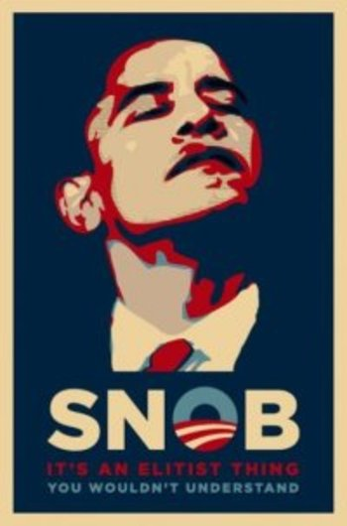
Transfer Illustrations

Slide 26
What do you think about this??

