Slide 1
Health Skills/Goal Setting
Glencoe Health
Pages 34-73

Slide 2
1. Health Skills (2)
Communication
Refusal
Conflict resolution
Accessing info
Analyzing influences
Practicing healthful behaviors
Stress management
Advocacy
Decision making
Goal setting

Slide 3
2. Interpersonal Communication
Exchange of thoughts, feelings & beliefs between 2 or more people

Slide 4
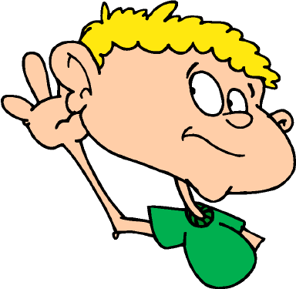
3. Strengthen interpersonal Communication Skills:
Use “I messages to express feelings
Communicate w/ respect & caring
Be an active listener

Slide 5
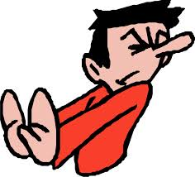
4. Refusal Skills
Communication strategies that can help you say no when you are urged to take part in behaviors that are unsafe or unhealthful, or that go against your values

Slide 6
5. Refusal Strategies
Say no in a firm voice
Explain why
Other alternatives
Stand your ground
Leave if necessary

Slide 7
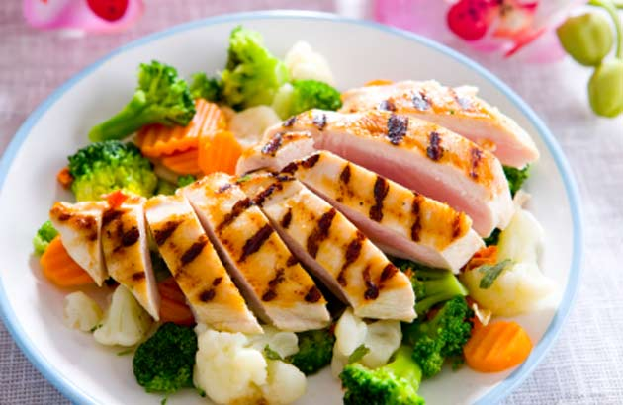
6. Health Habits
Eat well-balanced meals

Slide 8
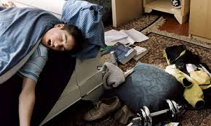
6. Health Habits
8 hours sleep a night

Slide 9
6. Health Habits
Avoid using tobacco, alcohol & other drugs

Slide 10
6. Health Habits
Floss & brush teeth regularly

Slide 11
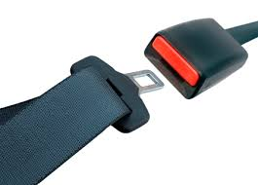
6. Health Habits
Wear safety belt

Slide 12
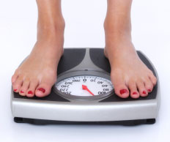
6. Health Habits
Stay w/in 5 pounds of my healthy weight

Slide 13
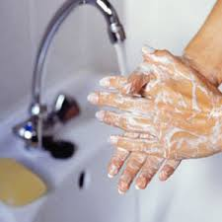
6. Health Habits
Practice good personal hygiene habits

Slide 14
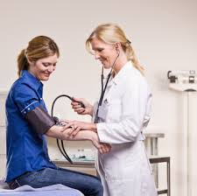
6. Health Habits
Get regular physical checkups

Slide 15
6. Health Habits
Keep a positive attitude

Slide 16
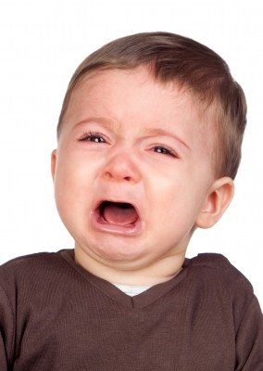
6. Health Habits
Express emotions in healthy ways

Slide 17
6. Health Habits
Take responsibility for my actions

Slide 18
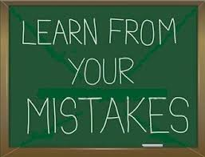
6. Health Habits
Think of mistakes as chances to learn

Slide 19
6. Health Habits
Relate well to family, friends & peers

Slide 20
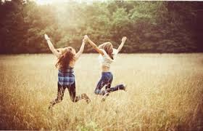
6. Health Habits
Have 1 or more close friends

Slide 21
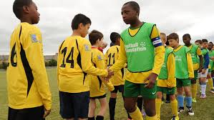
6. Health Habits
Treat others with respect

Slide 22
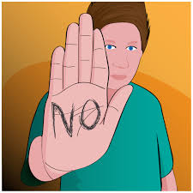
6. Health Habits
Use refusal skills to avoid risk behaviors

Slide 23
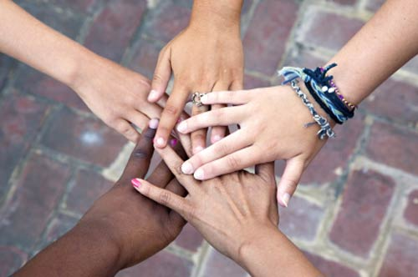
6. Health Habits
Get along with many kinds of people

Slide 24
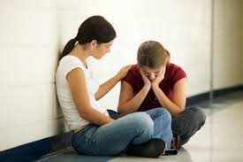
6. Health Habits
Put myself in other people’s place & understand their problems

Slide 25
6. Health Habits
Volunteer to help others whenever I can

Slide 26
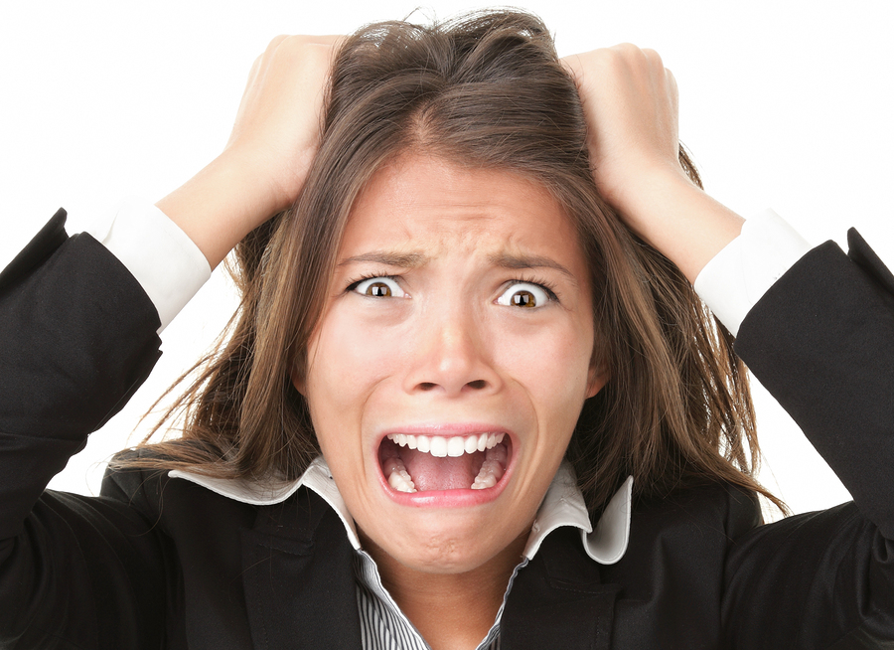
7. Stress
The reaction of the body & mind to everyday challenges & demands

Slide 27
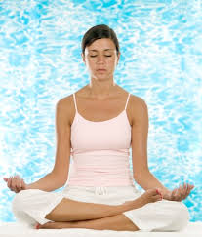
8. Stress Management Skills
Skills that help you reduce & manage stress in your life

Slide 28
9. Values
The ideas, beliefs, & attitudes about what is important that help guide the way you live

Slide 29
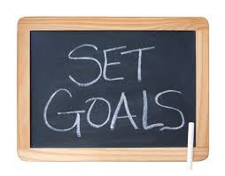
10. Goals
Those things you aim for that take planning & work

Slide 30
11. Short-term Goal
A goal that you can reach in a short period of time

Slide 31
12. Long-term Goal
A goal that you plan to reach over an extended period of time

Slide 32
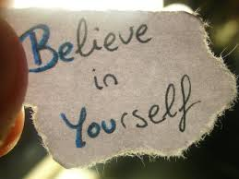
13. Self-esteem
How much you value, respect & feel confident about yourself

Slide 33
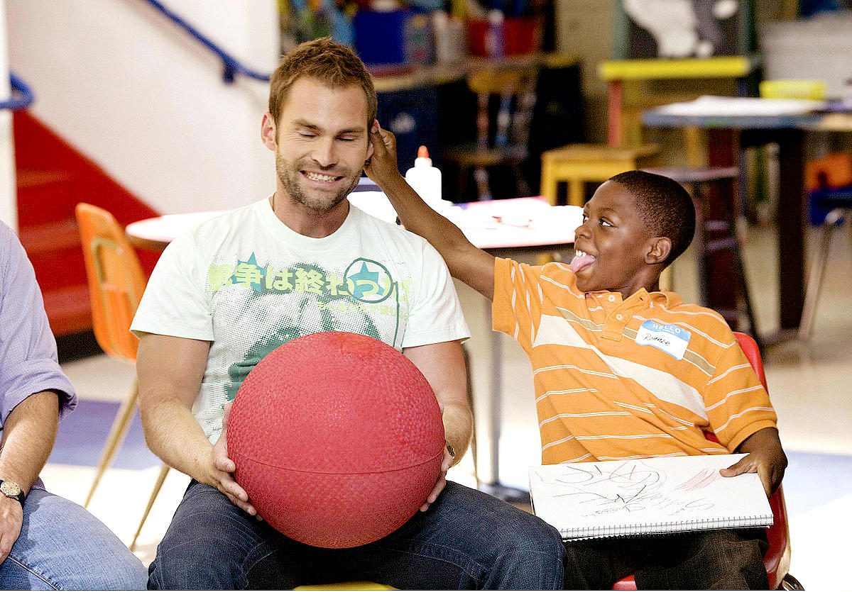
14. Role Model
Someone whose success or behavior serves as an example to you

Slide 34
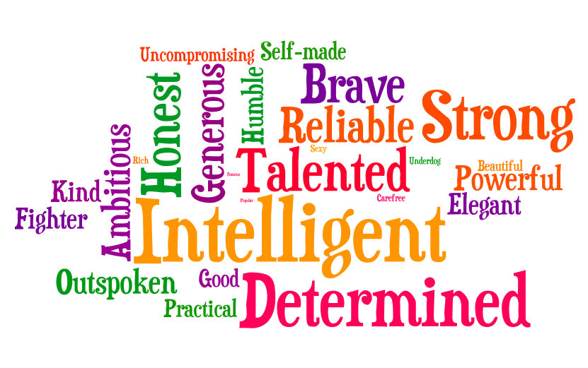
15. Personality
Complex set of characteristics that make you unique

Slide 35
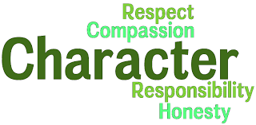
16. Character
The distinctive qualities that describe how a person thinks, feels, & behaves.

