Slide 1
Air Head Candy
Rylei,Jessica,Catie,Devin,Caroline and Anthony

Slide 2
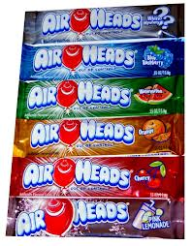
AIRHEADS CANDY

Slide 3
Our Glider
List Your Materials
Tape
Paper
Card board
Shoe box
styrofoam
airheads Glider

Slide 4
Best Test Flight
Our most successful test flight was 3.42m
The altitude was 1.41m

Slide 5
Glide Slope
Glide slope and interpretation
our glide slope
Well this is our highest and the farthest glide slope.
3.42 meters- Horizontal distance
1.41 meters – change in altitude
Glide slope ratio= 2.4 meters

Slide 6
Aspect Ratio
Aspect Ratio 6.3
1.9 M=Tip to Tip
.30 Width of Wing

Slide 7
Description of Tests
Most of the time we cooperated and finished the glider on time.
One day the glider just fell apart.
We changed the wings, the nose, and the tail.

