Slide 1
Illegal Drugs

Slide 2
1. Substance Abuse
Any unnecessary or improper use of chemical substances for non-medical purposes

Slide 3
3. Illegal drugs
Chemical substances that people of any age may not lawfully manufacture, possess, buy or sell

Slide 4
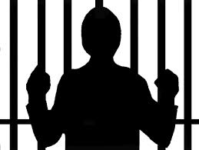
4. Illicit drug use
The use or sale of any substance that is illegal or otherwise not permitted
Includes prescription drugs for unintended person
It is a crime

Slide 5
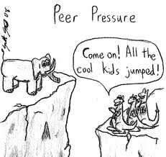
5. Factors that influence teens
Peer pressure
Family members
Role models
Media messages
Perceptions of drug behavior
Misleading information

Slide 6
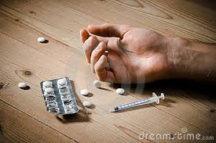
6. Overdose
A strong, sometimes fatal reaction to taking a large amount of a drug

Slide 7
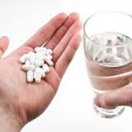
7. Tolerance
Condition in which the body becomes accustomed to the drug
Causes the user to experience a need for more & more of the drug to achieve desired effect

Slide 8
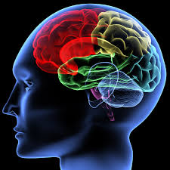
8. Psychological dependence
Condition that develops over time
Causes a person to believe a drug is needed in order to feel good or to function normally

Slide 9
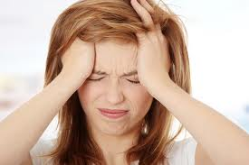
9. Physiological dependence
User develops a chemical need for a drug
Withdrawal symptoms occur:
Nervousness
Insomnia
Headaches
Vomiting
Chills
cramps

Slide 10
10. Addiction
Physiological or psychological dependence on a drug
Requires persistent, compulsive use of a substance
Professional intervention is often necessary to stop

Slide 11
11. Drugs take a heavy toll Consequences for the individual
Stop pursuing interests & goals
Engage in behaviors that can harm their physical health: Engage in sexual activity (STD’s)
Teen depression
More likely to be arrested (jail!)
Increased violence, crime & accidental death

Slide 12
12. Drugs take a heavy toll Consequences for friends & family
Stop spending time w/ friends & family
Family members feel the burden of the emotional & financial costs of drug abuse

Slide 13
13. Drugs take a heavy toll Consequences for others
If pregnant- can pass drugs to fetus
Can be born w/ birth defects, behavioral problems or drug addiction
Nursing mother can pass drugs through breast milk

Slide 14
14. Drugs take a heavy toll Consequences for society
Drug-related crime & violence
DWI/DUI= injuries & deaths
Costs economy $180 billion each year:
Lost work hours & productivity (illness, jail time, accidents, deaths)
Health care costs & legal fees
Law enforcement costs, insurance costs

Slide 15
15. Marijuana
A plant whose leaves, buds, & flowers are usually smoked for their intoxicating effects
Aka grass, weed, pot
One of most widely used illegal drugs
Hashish/hash= stronger form of marijuana
Considered a gateway drug

Slide 16
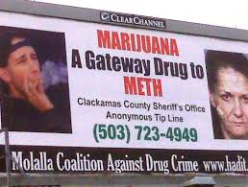
16. Gateway Drug
a drug that may lead to the user to try other, more dangerous drugs

Slide 17
17. Health risks of marijuana
Hallucinations/paranoia
Impaired short term memory, reaction time, concentration & coordination
Lung irritation, coughing
Heart & lung damage
Increase risk of lung cancer
Weakened immunity to infection
Increased appetite
Increase risk of stillbirth & birth defects
Changed hormone levels
Females- risk of infertility
Males- lowered sperm count & testosterone

Slide 18
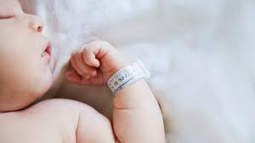
18. Infertility
Inability to bear children

Slide 19
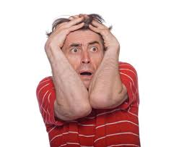
19. Paranoia
an irrational suspiciousness or distrust of others

Slide 20
20. Inhalants
Substances whose fumes are sniffed or inhaled to give effect
Prescribed by doctor (allergies/asthma)
Solvents, aerosols, glues, paints, varnishes & gasoline
Depress central nervous system
Glassy stare, slurred speech, nausea, coughing, nosebleeds, liver damage, etc.

Slide 21
21. Anabolic-androgenic steroids
Synthetic substances similar to male sex hormones
Unnatural muscle growth
Weight gain, acne, high blood pressure, liver & kidney tumors
Violent behavior, mood swings, depression, paranoia
Males- Shrinking testicles, reduced sperm count, baldness, breasts, prostate cancer
Females- facial hair, menstrual cycle changes, deepened voice

Slide 22
22. Psychoactive drugs
Chemicals that affect the central nervous system & alter activity in the brain
Stimulants
Depressants
Opiates
hallucinogens

Slide 23
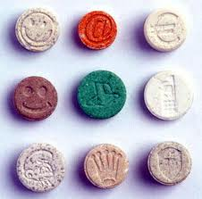
23. Club drugs
Drugs found at concerts, dance clubs & drug parties/raves
Disguised in foods
Slipped into drinks & taken without knowledge

Slide 24
24. Designer drugs
Synthetic drugs that are made to imitate the effects of other drugs
Cam be several hundred times stronger than the drugs they imitate

Slide 25
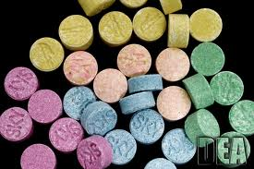
25. MDMA is also known as Ecstasy

Slide 26
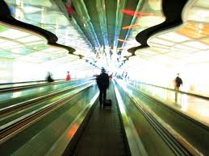
26. Hallucinogens
Drugs that alter moods, thoughts & sense perceptions including vision, hearing, smell & touch

Slide 27
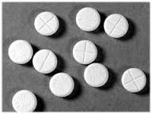
Rohypnol is another name for Roofies.
(Date rape drug)

Slide 28
28. Depressants
Drugs that tend to slow the central nervous system

Slide 29
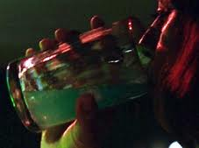
29. GHB can be used as a date-rape drug.

Slide 30
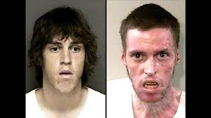
30. Meth is a white, odorless powder that can be dissolved in alcohol or water.

Slide 31
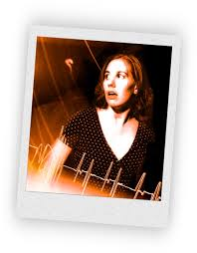
31. Stimulants
Drugs that speed up the central nervous system

Slide 32
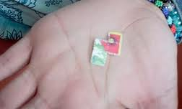
32. LSD
Acid
Can cause hallucinations & severely distorted perceptions of sound & color
Flashbacks can occur long after its use

Slide 33
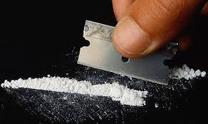
33. Cocaine
Rapidly acting, powerful & highly addictive stimulant
White powder
Illegal
Surge of self-confidence & euphoria

Slide 34
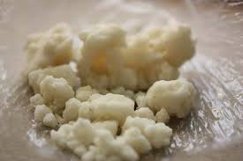
34. Crack
Dangerous form of cocaine
Called rock or freebase rock
Smoked or inhaled
In blood= causes heart rate & blood pressure to soar to dangerous levels
Death due to cardiac or respiratory failure

Slide 35
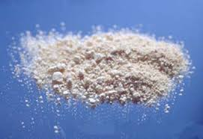
35. Amphetamines
Highly addictive
Use to stay alert, improve athletic performance or lose weight
Regular use= irregular heartbeat, aggressive behavior, heart failure

Slide 36
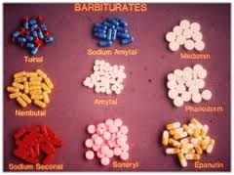
36. Barbiturates
Sedatives
Rarely used for medical purposes
Cause mood changes, excessive sleepiness & coma

Slide 37
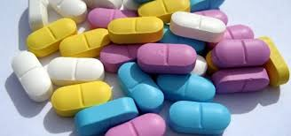
37. Tranquilizers
Depressants that relieve anxiety, muscle spasms, sleepiness & nervousness
When overused= physiological & psychological dependence, coma & death

Slide 38
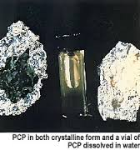
38. PCP is another name for angel dust.

Slide 39
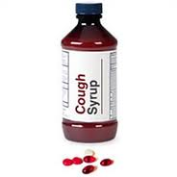
39. DXM is another name for tussin.

Slide 40
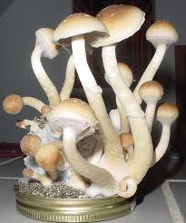
40. Hallucinogens found in Nature:
Psilocybin (Mushrooms)
Mescaline (Peyote cactus)

Slide 41
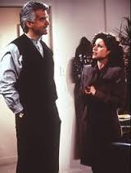
41. Opiates
Narcotics
Drugs such as those derived from the opium plant that are obtainable only by prescription
Are used to relieve pain

Slide 42
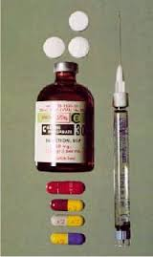
42. Codeine
Highly addictive ingredient in some prescription cough medicines
Causes drowsiness

Slide 43
43. Morphine
Treats severe pain
Used for a short time
Side effects:
Fast or slow heartbeat
Seizures
Hallucinations
Blurred vision
Rashes
Difficulty swallowing

Slide 44
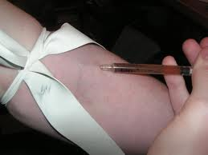
44. Heroin
Processed form of morphine
Injected, snorted or smoked
Many forms: white or brownish powder & black, sticky tar
Slows breathing & pulse

Slide 45
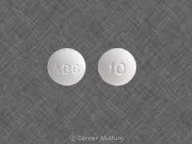
45. Oxycodone
Prescription drug that helps relieve moderate to severe pain
Contains a strong opiate
Side effect: suppression of respiratory system

Slide 46
46. Refusal Statements
“No thanks, I don’t do drugs.”
“I can’t. I’m on medication.”
“I’m not interested. That stuff makes me sick.”
?No. I have to be in great shape for tomorrow’s game.”

Slide 47
47. Healthy alternatives to drugs
Hobbies
Sports
Community activities
School organizations

Slide 48
48. Drug-free school zones
Areas within 1000-1500 feet of schools & designated by signs, within which people caught selling drugs receive especially severe penalties
Zero tolerance
Locker searches

Slide 49
49. Drug watches
Organized community efforts by neighborhood residents to patrol, monitor, report & otherwise try to stop drug deals & drug abuse

Slide 50
50. Rehabilitation
Process of medical & psychological treatment for physiological or psychological dependence on a drug or alcohol
Outpatient drug-free treatment
Short-term treatment
Maintenance therapy (heroin-meds)
Therapeutic communities (6-12 months)

