Slide 1
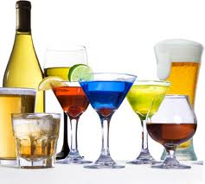
Alcohol

Slide 2
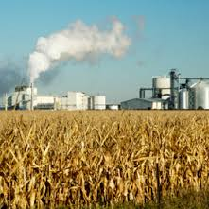
1. Ethanol
type of alcohol in alcoholic beverages
Powerful & addictive drug
Can be produced synthetically or naturally by fermenting fruits, vegetables & grains

Slide 3
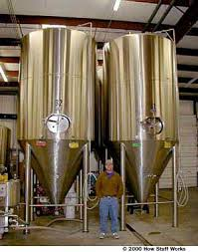
2. Fermentation
Chemical reaction of yeast on sugars
Water, flavorings & minerals are mixed w/ ethanol to produce beverages:
Beer
Wine
Flavored malt liquor drinks
Spirits/liquors (whiskey/vodka)

Slide 4
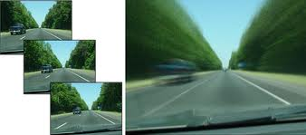
3. Depressant
Drug that slows down the central nervous system
Slows reaction time
Impairs vision
Diminishes judgment

Slide 5
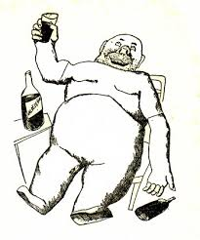
4. Intoxication
State in which the body is poisoned by alcohol or another substance
Person’s physical & mental control are significantly reduced
Alcohol stays in the body until liver can metabolize it/break it down

Slide 6
5. Factors that Influence Alcohol’s Effects
a. Body size
Smaller person feels effect of the same amount of alcohol faster than a large person

Slide 7
5. Factors that Influence Alcohol’s Effects
B. gender
Alcohol moves into bloodstream faster in females than males

Slide 8
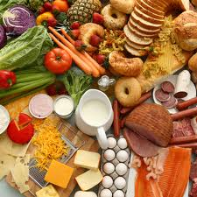
5. Factors that Influence Alcohol’s Effects
C. food
Food in stomach slows down passage of alcohol into bloodstream

Slide 9
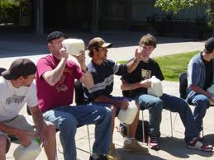
5. Factors that Influence Alcohol’s Effects
D. rate of intake
If person drinks faster than the liver can break it down, person becomes intoxicated

Slide 10
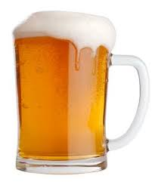
5. Factors that Influence Alcohol’s Effects
E. amount
As amount of alcohol increases, the level of alcohol in bloodstream rises

Slide 11
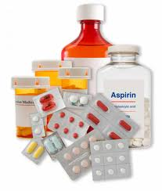
5. Factors that Influence Alcohol’s Effects
F. medicine
Alcohol can interfere w/ effects of medicines
Medicines can heighten effects of alcohol

Slide 12
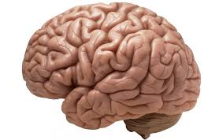
6. Short Term Effects of Alcohol
A. Changes to the Brain
Development (pathways for learning damaged)
Memory (thought process disorganized)
Judgment & control (judgment altered, coordination impaired)
Risk of stroke (increased in young people)

Slide 13
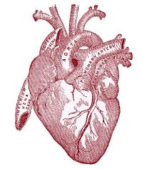
6. Short Term Effects of Alcohol
B. Cardiovascular changes
Heart
Small amounts increase heart rate & blood pressure
Large amounts- opposite effect, heart rhythm irregular, body temperature drops

Slide 14
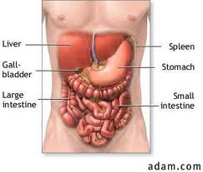
6. Short Term Effects of Alcohol
C. Liver & Kidney Problems
Liver: Toxic chemicals released
Kidneys: Urine output increased/dehydration

Slide 15
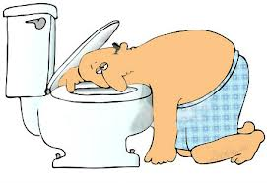
6. Short Term Effects of Alcohol
D. Digestive System Problems
Stomach: alcohol increases stomach acid production
Can cause nausea & vomiting

Slide 16
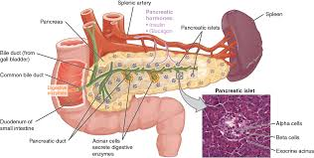
6. Short Term Effects of Alcohol
E. Pancreas Problems
Pancreatitis: acute, severe pain

Slide 17
7. Typical alcohol-drug interactions
Body may absorb drug or alcohol more slowly= in the body longer
Can decrease effectiveness of some medications & increase others
Enzymes in body can change meds into chemicals that can damage liver & other organs

Slide 18
8. Long Term Effects of Alcohol
Damage brain cells & reduction in brain size
Increase blood pressure (heart attack/stroke)
Build up of fat cells in liver (cells die)
Damage to digestive lining of stomach (ulcers, cancer)
Destruction of pancreas

Slide 19
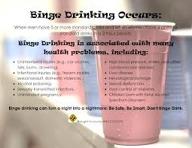
9. Binge Drinking
Drinking 5 or more alcoholic drinks at one sitting

Slide 20
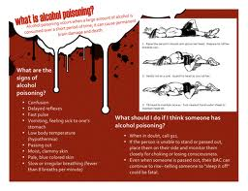
10. Alcohol Poisoning
Severe & potentially fatal physical reaction to an alcohol overdose

Slide 21
11. Effects of Alcohol Poisoning
Mental confusion
Coma/inability to be roused
Vomiting & seizures
Slow respiration (10 seconds between breaths)
Irregular heartbeat
Hypothermia (low body temp)- pale/bluish skin

Slide 22
12. Psychological dependence
Condition in which the person believes that a drug is needed in order to feel good or to function normally

Slide 23
13. Physiological dependence
Condition in which the user has a chemical need for a drug

Slide 24
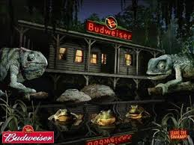
14. Factors that influence alcohol use
Peer pressure
Family
Media messages

Slide 25
15. It is illegal for anyone under the age of 21 to buy, possess, or consume alcohol.

Slide 26
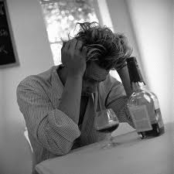
16. Alcohol abuse
Excessive use of alcohol

Slide 27
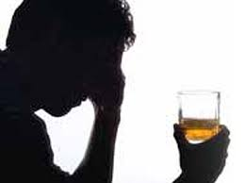
17. Alcoholism
disease in which a person has a physical or psychological dependence on drinks that contain alcohol

Slide 28
18. Benefits of living alcohol-free
Maintaining a healthy body
Establishing healthy relationships
Making healthy decisions
Avoiding risky behaviors
Avoiding illegal activities
Avoiding violence
Achieving your goals

Slide 29
19. Blood alcohol concentration (BAC)
Amount of alcohol in a person’s blood, expressed as a percentage
Depends on quantity & type of alcohol that was consumed, rate of consumption, body size & gender
0.08% = drunk driving

Slide 30
20. Consequences of driving while intoxicated
Injuries or death to driver & others
Arrest, jail time, court appearance & fine or bail, police record, possible lawsuits
Severely restricted driving privileges &/or immediate confiscation of driver’s license
Higher auto insurance rates or canceled auto insurance policy

Slide 31
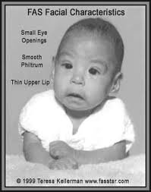
21. Fetal Alcohol Syndrome (FAS)
Group of alcohol-related birth defects that include physical & mental retardation

Slide 32
22. Effects of fetal alcohol syndrome
Small head & deformities of face, hands, feet
Heart, liver, & kidney problems
Vision & hearing problems
Central nervous system problems, developmental disabilities, & poor coordination
Difficulties learning, short attention span
Hyperactivity, anxiety & social withdrawal

Slide 33
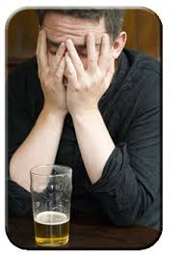
23. Alcoholic
An addict who is dependent on alcohol
Behaviors= violent or withdrawn
Due to genetics, etc.

Slide 34
24. 3 Stages of Alcoholism
Stage 1: Abuse
Social drinking
Physical & psychological dependence develops
Memory loss & blackouts
Begin to lie or make excuses to justify drinking

Slide 35
24. 3 Stages of Alcoholism
Stage 2: Dependence
Cannot stop drinking
Physically dependent on alcohol
Tries to hide problem
Performance at work & home suffers

Slide 36
24. 3 Stages of Alcoholism
Stage 3: Addiction
Addicted
Liver damaged
Severe withdrawal if he/she stops drinking

Slide 37
25. Recovery
Process of learning to live an alcohol-free life

Slide 38
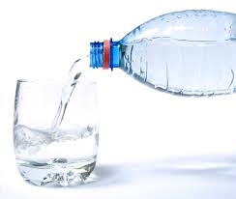
26. Sobriety
Living without alcohol

Slide 39
27. Resources to help alcoholics & their families
Al-Anon/Alateen
Alcoholics Anonymous
Mothers Against Drunk Driving (MADD)
National Association for Children of Alcoholics
National Drug & Alcohol Treatment Referral Routing Service
Students Against Destructive Decisions (SADD)
National Clearinghouse for Alcohol & Drug Information

