Slide 1
4.3 Graphing Horizontal and Vertical Lines
Students will graph horizontal and vertical lines.

Slide 2
4.3 Graphing Horizontal and Vertical Lines
VOCABULARY
Constant function
A constant function is a function of the form y = b, where b is a number.

Slide 3
4.3 Graphing Horizontal and Vertical Lines
EQUATIONS OF HORIZONTAL AND VERTICAL LINES
y = b
x = a
In the coordinate plane, the graph of y = b is a line.
In the coordinate plane, the graph of x = a is a line.
horizontal
vertical

Slide 4
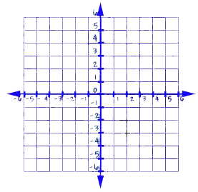
Example 1: Graph the Equation y = b Graph the equation y = -3.
-3
The equation does not have x as a variable. The y-coordinate is always , regardless of the value of x. Some points are that are solutions of the equation are:
(-3, ), (0, ), and (3, )
The graph of y = -3 is a line units the .
-3
-3
-3
horizontal
3
below
x-axis

Slide 5
Example 2: Graph the Equation x = a Graph the equation x = 2
2
The equation does not have y as a variable. The x-coordinate is always , regardless of the value of y. Some points are that are solutions of the equation are:
( -3), ( , 0), and ( , 3)
The graph of x = 2 is a line units the .
2
2
2
vertical
2
right of
y-axis

Slide 6
Example 3: Write an Equation
Write the equation of the line in the graph.
a.
b.
Solution
The graph is a line. The x-coordinate is always . The equation of the line is .
The graph is a line. The y-coordinate is always . The equation of the line is .
vertical
4
x = 4
horizontal
-2
y = -2
Notes:
Finish with p. 85 note guide.

Slide 7
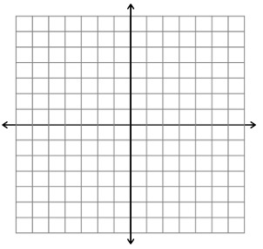
CHECKPOINT Complete the following exercises
Graph the equation x = - 3
Write the equation of the line in the graph
2

Slide 8
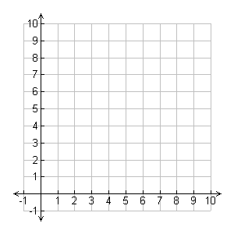
Example 4 Write a Constant Function
Tree Trunks The graph shows the diameter of a tree trunk over a 6-week period. Write an equation to represent the diameter of the tree trunk for this period. What is the domain of the function? What is the range.
Diameter (in.)
Solution
Number of Weeks
From the graph, you can see that the diameter was about inches throughout the 6-week period. Therefore, the diameter D during this time t is D = . The domain is . The range is .
6 in
0, 1, 2, 3, 4, 5, 6
6 in

