Slide 1
Trail Dedication Day
April 13, 2013

Slide 2
Trail cutting

Slide 3
Trail Committee with PCCD receiving Grant $ for Trail Sign

Slide 6
Trail Kids Club meet weekly

Slide 7
Trail Kids writing to Coal Mines

Slide 8
Trail kids making a Timeline

Slide 9
Planning the Fossil Dig

Slide 10
Volunteer Mr. Steele & Boy Scout Sam Velez

Slide 11
Fossil Dig in Progress expected completion date June 2013

Slide 12
Trail Kids Club

Slide 13
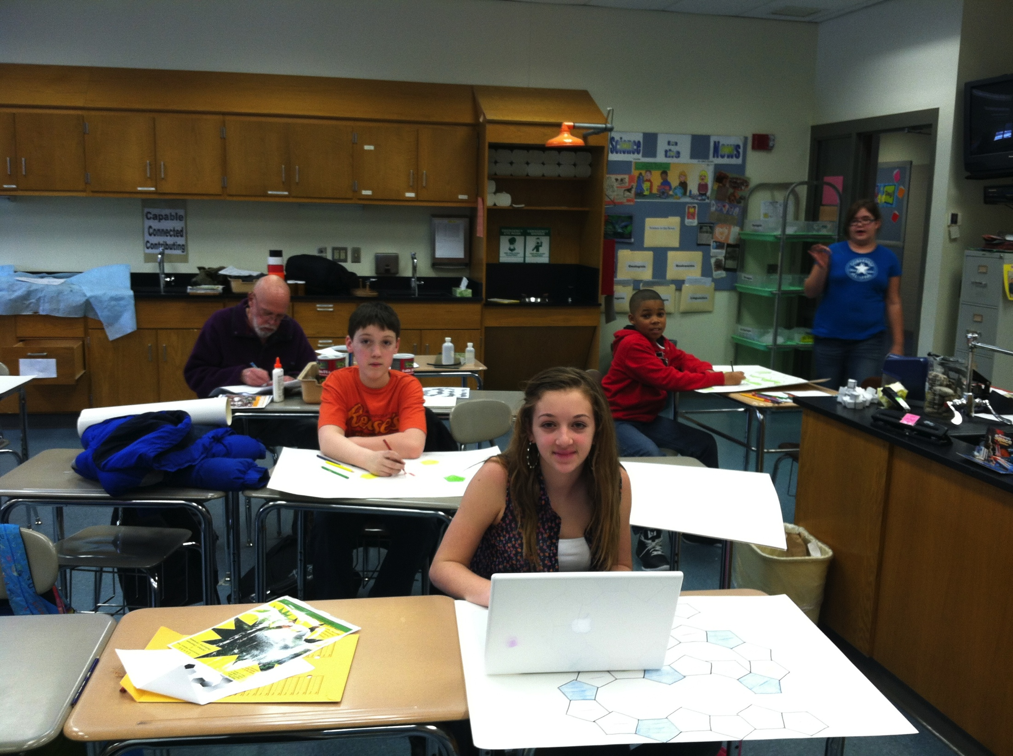
Trail Kids Club

Slide 14
Deciding where to cut Learning Stations

Slide 15
BEFORE construction…

Slide 16
Ground breaking for Pavilion

Slide 19
….DURING….

Slide 20
…..During…

Slide 21
…AFTER!!! (Completed just days before the dedication)

Slide 22
Trevor Yip Built 8 Picnic Tables-( 2 are handicap accessible)

Slide 25
Starting the ampitheatre

Slide 26
Louis Wolverton finishing his Eagle Scout Project

Slide 27
Amphitheatre is ready to use for dedication!

Slide 28
Event Planners Cindy Pellington & Linda Stein open the Trail Dedication Ceremony

Slide 29
Troop #87 leads the Flag ceremony

Slide 30
Flag Ceremony

Slide 31
LIS Leading the Alma Maters -( North & South)

Slide 32
LIS Crew entertains the crowd!

Slide 33
National Park Service Ranger Michael Golore

Slide 34
Ranger speaks about importance of experiencing the outdoors

Slide 36
Huge crowd attended the ceremony!

Slide 37
Mrs. Stein accepts check from PPL Alana Roberts for Fossil Dig Grant

Slide 38
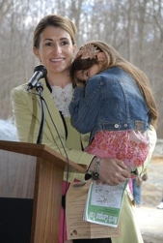
PA Representative Rosemary Brown
Speaks at the dedication

Slide 39
Superintendent Sharon Laverdure gives closing remarks

Slide 40
Official Ribbon Cutting

Slide 41
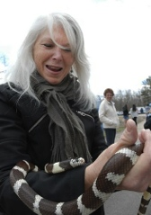
Famous author
Lindsay Barrett George
Participated in Trail Dedication

Slide 42
Lindsay Barrett George
held story readings
& helped the students draw nature

Slide 43
Scout Louis Woverton in front of his completed Project

Slide 44
Everyone loved the animals from Pocono Environmental Rehabilitation

Slide 45
LIS GIFTED program held puppet shows

Slide 47
Best Friends come far to share the day!

Slide 48
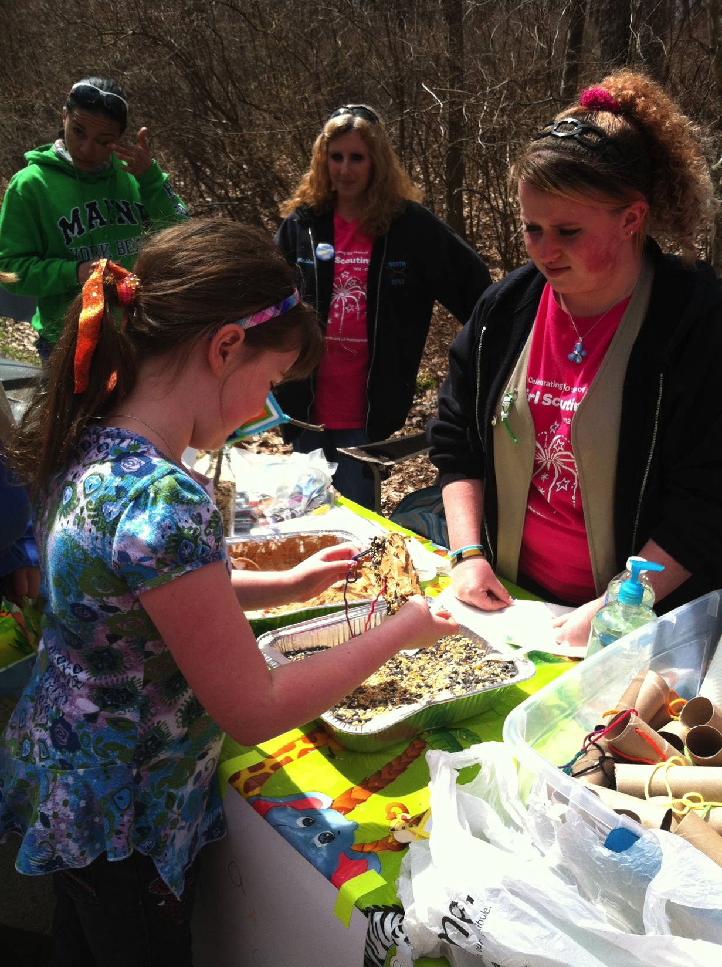
Girl Scout Troop had a Booth to make Bird Feeders! The crowd loved it!

Slide 49
LIS Student Council Members made musical Instruments

Slide 50
Trail Signs for Sale. Contact linda-stein@esasd.net

Slide 51
Cost $30 with “Donated by….” or “ In Loving memory of…”

Slide 52
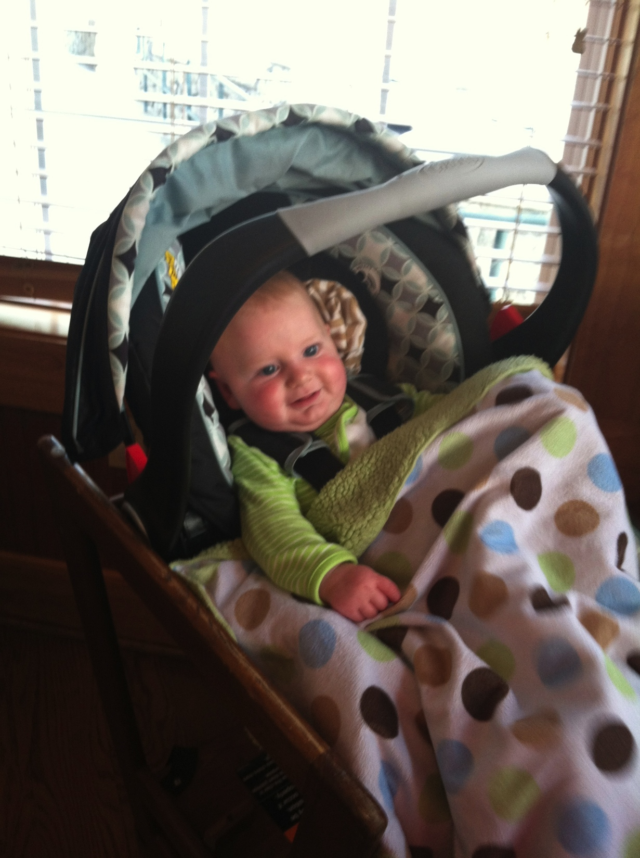
Young & old shared the day!

Slide 53
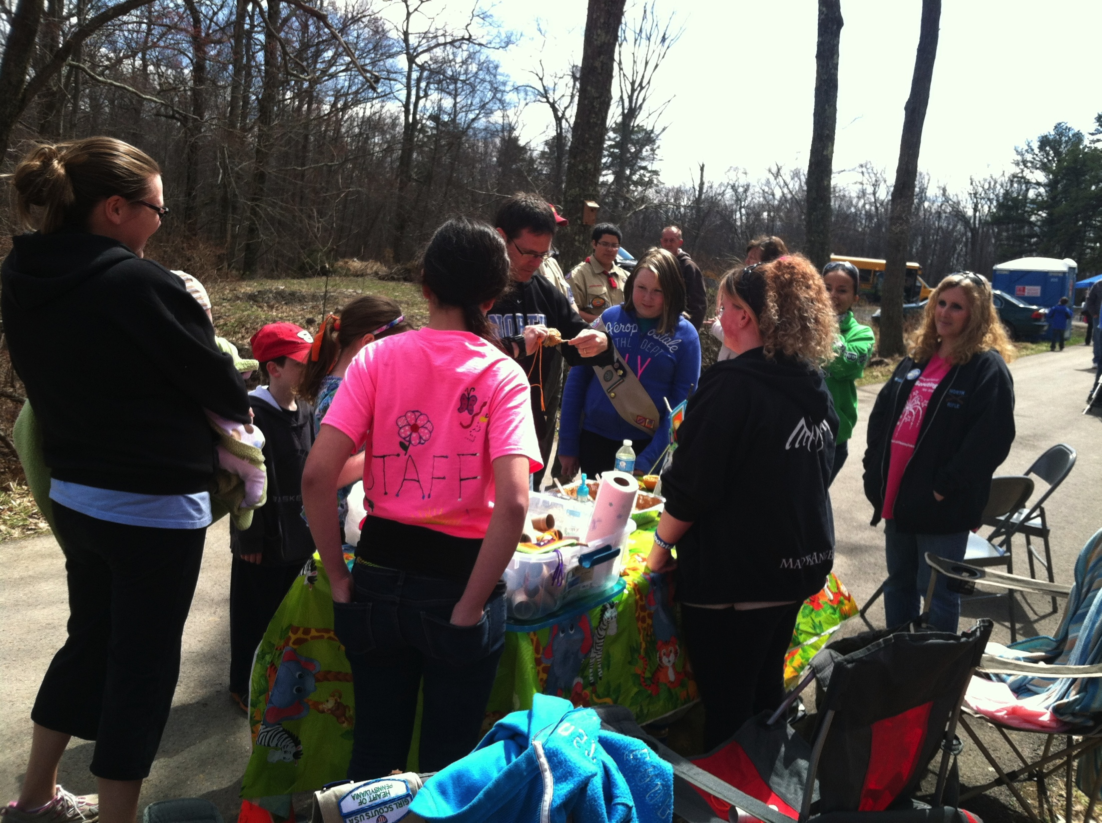
Mr. Zall makes a bird feeder

Slide 54
North Honor Society Face Painting Booth was a hit!

Slide 55
LIS Student Council enjoys the instruments they made for the Trail!

Slide 56
Mrs. Pellington enjoying the day with Granddaughter Colleen!

Slide 57
Creator Linda Stein along with Larry McKenna relax after the event!

Slide 58
Planners relax after the event

Slide 59
Snake & Animal Farm
Copperhead

Slide 60
Snake & Animal Farm
Rattlesnake

Slide 61
Gifted Students preparing for our Deer Exclosure project

Slide 62
Pictures of the event
If you have any pictures of the day, THAT YOU WOULD LIKE TO SHARE, PLEASE EMAIL THEM TO MRS PELLINGTON
cynthia-pellington@esasd.net

