Slide 1
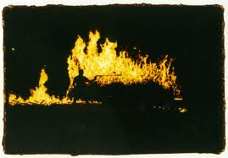
Fire throwers
Joe lianna calvin laura christian brad toakachi

Slide 2
Our Glider
Tape
Styrofoam
Shoebox
Paper
Cardboard
Graphite
Pencil

Slide 3
Our Design
Our wings looked like a regular piece of Styrofoam , but on the ends it was slanted down.
Our tail was jutted out of the back of our box and had a crossbar across it and a piece of cardboard stood up on top.
Our cardboard box looked like a box.

Slide 4
Test Flight
Recorded Distance and Flight
Our gilder flew 3.00 meters.
Our first flight was 3.00 meters.
Our second flight was 2.47 meters.
Our last flight was 2.53 meters.

Slide 5
Glide Slope
Ratio=2.1
3meters=Horizontal Distance
1.42 meters=change in altitude

Slide 6
Aspect Ratio
.96 meters Tip To Tip of wing
.23 meters Width of wing
Aspect Ratio = 4.2
We divided .96 by .23 and got 4.2 meters.

