Slide 1
7.1 Graphing Linear Systems
p. 142 – 144
Students will estimate the solution of a system of linear equations by graphing.

Slide 2
7.1 Vocabulary p. 142
System of linear equations
Solution of a linear system
Point of intersection
Two or more linear equations in the same variable form. This is also called a linear system.
An ordered pair (x, y) that makes each equation in the system a true statement.
A point (a, b) that lies on the graphs of two or more equations is a point of intersection for the graphs.

Slide 3
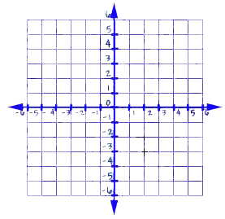
p. 142: Example 1 Find the Point of Intersection
Use the graph at the right to estimate the solution of the linear system. The check your solution algebraically.
x + 2y = -4
x + 2y = -4 Equation 1
x – 3y = 1 Equation 2
x - 3y = 1
Solution
The lines appear to intersect one at ( , )
Check Substitute for x and for y in each equation.
x + 2y = -4 x – 3y = 1
+ 2( ) = -4 - 3( ) = 1
= -4 = 1
Answer Because ( , ) is a solution of each equation, ( , ) is the solution of the system of linear equations
-2 -1
-2
-1
-2
-1
-2
-1
-4
1
-2 -1
-2 -1

Slide 4
p. 143 SOLVING A LINEAR SYSTEM USING GRAPH-AND-CHECK
Step 1 Write each equation in a form that is .
Step 2 Graph both equations in the .
Step 3 Estimate the coordinates of the .
Step 4 Check whether the coordinates give a solution by
them into each equation of the
linear system.
easy to graph
same coordinate plane
point of intersection
substituting
original

Slide 5
p. 143 continued on next slide! Example 2: Graph and Check Linear System
Use the graph-and-check method to solve the linear system.
5x + 4y = -12 Equation 1
3x - 4y = -20 Equation 2
Write each equation in slope-intercept form.
Equation 1 Equation 2
5x + 4y = -12 3x - 4y = -20
4y = -12 - 4y = - 20
y = y =
-5x
-3x
-5x – 3
4
3x + 5
4

Slide 6
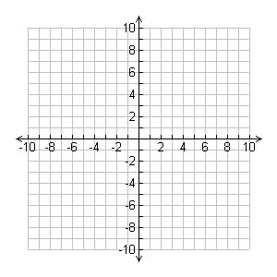
p. 143 continued on next slide! Example 2: Graph and Check Linear System
2. Graph both equations.
3. Check from the graph that the
point of intersection is ( , ).
Check whether ( , ) is a
solution by substituting for
x and for y in each of the
original equations.
Equation 1 Equation 2
5x + 4y = -12 3x - 4y = -20
5( ) + 4( ) = -12 3( ) – 4( ) = -20
= -12 = -20
-4, 2
-4, 2
-4
2
-4
2
-4
2
-12
20

Slide 7
7.1 Graphing Linear Systems p. 142 example 2: Estimate the solution of a system of linear equations by graphing.
Answer
Because ( , ) is a solution of each equation in the linear system, ( , ) is a solution of the linear system.
-4, 2
-4, 2

Slide 8
p. 144: CHECKPOINT Use the graph-and-check method to solve the linear system.
3x – 4y = 4 x + 2y = 8 | 5x + 2y = 4 9x + 2y = 12

Slide 9
p. 144: CHECKPOINT Use the graph-and-check method to solve the linear system.
3. y = -2x -3 2x + 5y = 25 | y = 3x + 4 7x – 3y = -6

