Slide 1
4.5 The Slope of a Line
p. 89 – 91
Students will find the slope of a line.

Slide 2
p. 89 Vocabualry
Slope: “m”
The ratio of the vertical rise to the horizontal run between any two points on the line.
Rise
y₂ – y₁
Run
x₂ – x₁

Slide 3
p. 89 Example 1 The Slope Ratio
Find the slope of a ramp that has a vertical rise of 3 feet and a horizontal run of 18 feet.
Solution
m = = =
Vertical Rise = 3 feet
Horizontal Run = 18 feet
3
18
Rise
3
Run
18
3
18
Answer The slope of the ramp is .

Slide 4
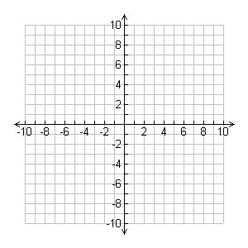
p. 89 THE SLOPE OF A LINE
The slope m of a line that passes through the points (x₁ , y₁ ) and (x₂ , y₂) is
=
=
Change in
Rise
y
Run
x
Change in
y₂ – y₁
x₂ – x₁

Slide 5
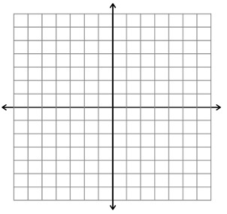
p. 90 Example 2 Positive Slope
Find the slope of the line that passes through the points (1,2) and (-2,-3).
Solution Let (x₁ , y₁ ) = (1,2) and (x₂ , y₂) = (-2,-3)
m = Formula for Slope
= Substitute values.
= Simplify.
= Slope is .
y₂ – y₁
x₂ – x₁
(1,2)
-3
-
2
-2
-
(-2,-3)
1
-5
5
3
-3
5
3

Slide 6
p. 90 Example 3 ZERO SLOPE
Find the slope of the line passing through the points (-2,-3) and (4, -3).
Solution Let (x₁ , y₁ ) = (-2,-3) and (x₂ , y₂) = (4, -3).
m = Formula for Slope
= Substitute values.
= Simplify.
= Slope is .
Answer The slope of the line is . The line is .
y₂ – y₁
x₂ – x₁
-3 – -3
4 – -2
(-2,-3)
(4,-3)
-3 + 3
0
6
4 + 2
0
6
0
horizontal

Slide 7
p. 91 Example 4 UNDEFINED SLOPE
Find the slope of the line passing through the points (-1,-4) and (-1,-2).
Solution Let (x₁ , y₁ ) = (-1,-4) and (x₂ , y₂) = (-1,-2).
m = Formula for Slope
= Substitute values.
= Division by is .
Answer Because division by is , the slope is . The line is .
y₂ – y₁
x₂ – x₁
-2 – -4
-1 – -1
-2
0
0
not possible
0
not possible
undefined
vertical

Slide 8
p. 91 Checkpoint Find the slope of the line passing through the points. Then state whether the slope of the line is positive, negative, zero, or undefined.
1. (-5,2) and (7,-2) | 2. (0,0) and (-9,0)
3. (-7,-8) and (-7,8) | 4. (2,-4) and (8,6)
-1
3
0
-9
negative
zero
5
3
16
0
undefined
positive

