Slide 1
4.6 Direct Variation p. 92 - 93
Students will write and graph equations that represent direct variation.

Slide 2
p. 92 Vocabulary
Direct variation
Constant of variation
The relationship between 2 variables x and y for which there is a nonzero number k such that y=kx. The variables x & y vary directly
The constant in a variation model.
example: y=kx (read…”y varies directly with x”
k is the non-zero constant

Slide 3
p. 92: Example 1: Write a Direct Variation Model
The variables in x and y vary directly. One pair of values is x = 7 and y = 21.
Write an equation that relates x and y.
Find the value of y when x = 4.
Solution
Because x and y vary the equation is of the form
y = kx Write a model for direct variation.
= k( ) Substitute for x and for y.
= k Divide each side by .
Answer An equation that relates x and y is .
y = 3( ) Substitute for x.
y = Simplify.
Answer When x = 4, y = .
directly
y = kx
21
7
7
21
3
7
y = 3x
4
4
12
12

Slide 4
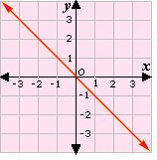
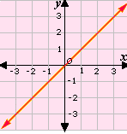
p. 93 PROPERTIES OF GRAPHS OF DIRECT VARIATION MODELS
The graph of y = kx is a line through the origin .
The slope of the graph of y = kx is k .
k is negative
k is positive

Slide 5
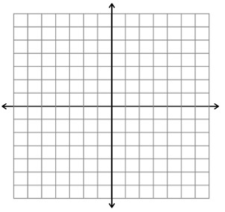
p. 93 Example 2: Graph a Direct Variation Model
Graph the equation y = -x.
Plot a point at the origin .
Find a second point by choosing any value of x and substituting it into the equation to find the corresponding y-value. Use the value -3 for x.
y = kx Write the original equation.
y = - ( -3) Substitute -3 for x.
y = 3 Simplify. (-3,3)
Plot the second point and
draw a line through the
origin and the second point.

Slide 6
p. 93 CHECKPOINT The variables x and y vary directly. Use the given values to write an equation that relates x and y.
1. x = 6, y = 30 | 2. X = 8, y = -20 | X = 3.6, y = 1.8

