Slide 1
Sexually Transmitted Diseases

Slide 2
1. STD is an acronym for Sexually Transmitted Diseases

Slide 3
2. STI is an acronym for Sexually Transmitted Infections.

Slide 4
3. Sexually Transmitted Diseases
Infections spread from person to person through sexual contact
Direct genital contact
Exchange of semen or other body fluids w/ infected person

Slide 5
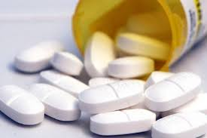
4. Some STDs are caused by a bacterial infection and can be cured with medication.

Slide 6
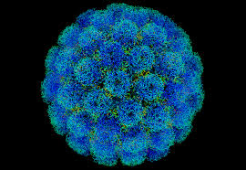
5. Other STDs are caused by viruses and are incurable.

Slide 7
6. Asymptomatic
Individuals show no symptoms, or the symptoms are mild & disappear after the onset of infection

Slide 8
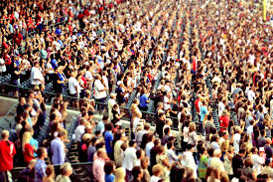
7. The risk of contracting an STD increases as the number of sexual partners increases.

Slide 9
8. Females are more likely to suffer complications with STDs, and the effects are more serious than in males.

Slide 10
9. Transmit
To send from one person to another

Slide 11
10. An estimated 19 million people are infected with an STD each year.

Slide 12
11. Almost half of people infected with an STD each eyar are under the age of 24.

Slide 13
12. Many STD cases go undiagnosed & untreated.
Embarrassment or fear

Slide 14
12. Many STD cases go undiagnosed & untreated.
Lack of symptoms

Slide 15
12. Many STD cases go undiagnosed & untreated.
Misinformation

Slide 16
12. Many STD cases go undiagnosed & untreated.
Notification policies

Slide 17
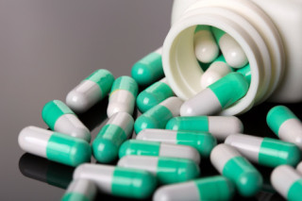
13. Antibiotics
A class of chemical agents that destroy disease-causing micro-organisms while leaving the patient unharmed

Slide 18
14. Abstinence is the only sure method of preventing STDs.

Slide 19
15. High-risk Behaviors
Being sexually active with more than one person

Slide 20
15. High-risk Behaviors
Engaging in unprotected sex

Slide 21
15. High-risk Behaviors
Engaging in sexual activity with high-risk partners

Slide 22
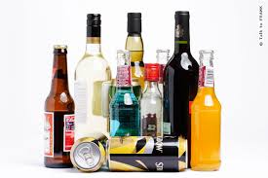
15. High-risk Behaviors
Using alcohol and other drugs

Slide 23
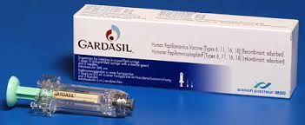
16. HPV Vaccine
A vaccine that can prevent cervical cancer, pre-cancerous lesions (or sores), & genital warts caused by genital HPV infection

