Slide 1
Bernoulli
Isabelle, Danielle, Tara, Gabby, Camille, Robert

Slide 2
Our Design
Triangular nose
Wings are rectangular with triangular points
Tail is triangular
String is on the back of plane

Slide 3
Our Glider
List Your Materials
Caption for Picture
Shoe Box
Duck Tape
Styrofoam
Ruler
Cardboard
Construction paper
Hair tie

Slide 4
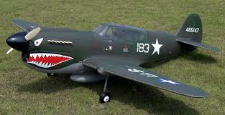
Test Flight
Recorded Distance and Flight
Picture Caption
Trial 1 :height 1.40 m distance: 3.34m
Trial 2: height 1.45m distance 3.19m
Trial 3: height 1.43m distance 3.36m

Slide 5
Glide Slope
Glide slope and interpretation
trial 1 : 2.39 glide slope ratio
trial 2 : 2.2 [G.S.R]
Trial 3: 2.34 [G.S.R]

Slide 6
Aspect Ratio
4.4 aspect ratio

Slide 7
Description of Tests
Our nose broke
Someone wasn’t cooperating
We had to do some repairs
Our plane flew the 3 meters each time
Our plane flew straight

